Slide 1
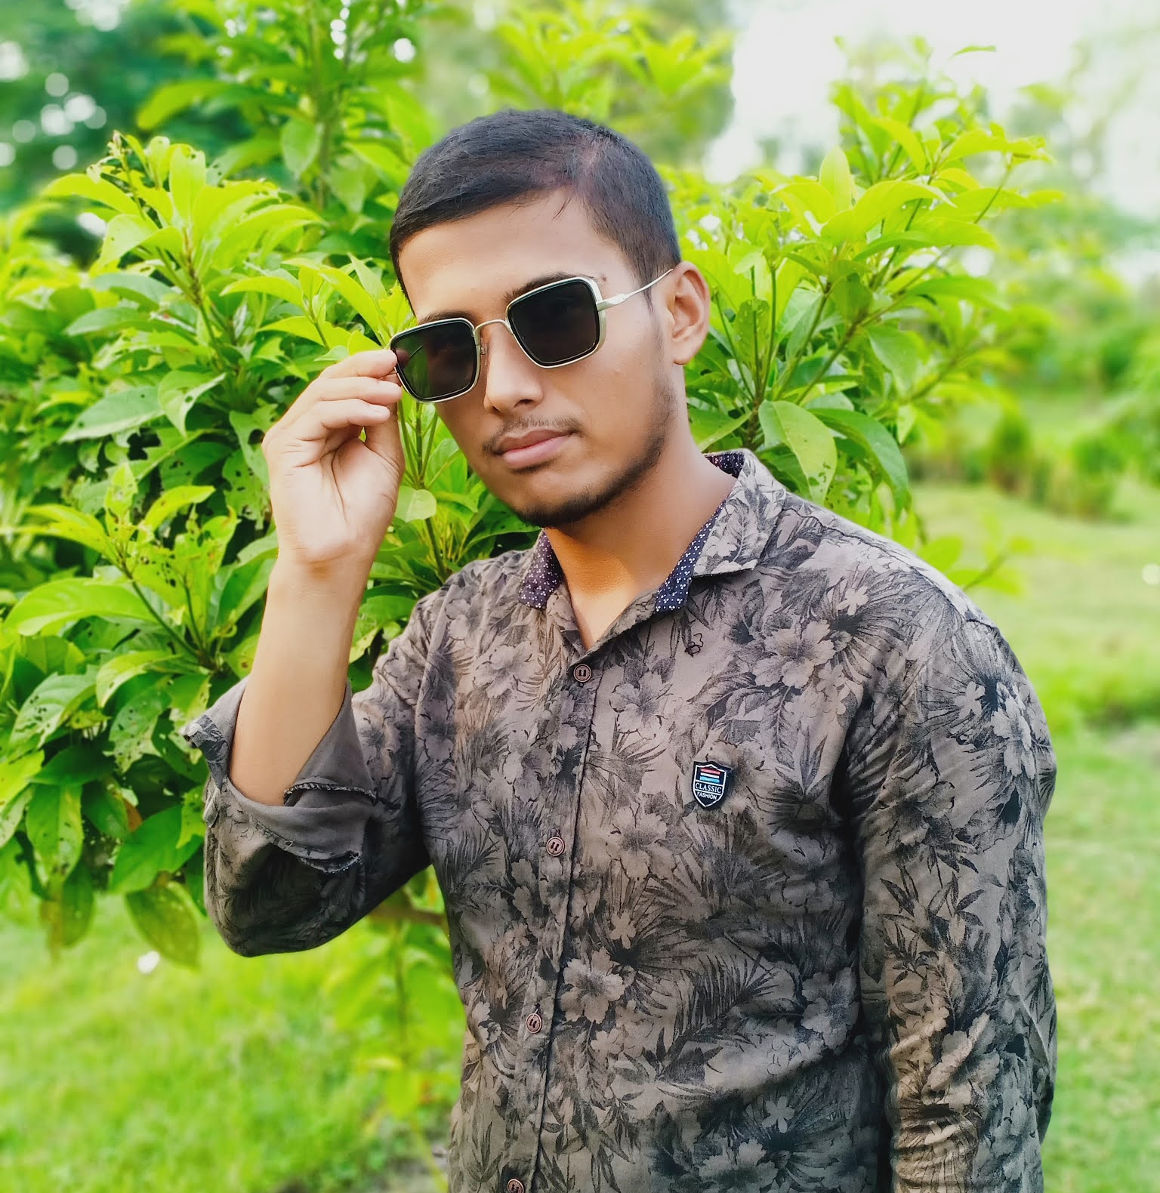
MAJEDUL ISLAM
National university : Nilphamari Govt. College

Slide 2
Life
Majedul Islam, a leader of Young Generation.
Simple & Islamic life leading.

Slide 3
Education
1
SSC (Science)
2
HSC (Science)
3
B.Sc (Mathematics)

Slide 4
work
1
Basic Computer Operator
Majedul’s professional journey is characterized by a series of dynamic roles and contributions.
2
Apps Developer ( Flutter & Dart )
3
Programmer
4
Graphic Designer
4
Freelancer

Slide 5






profile
1
majedulnil
2
majedulnil
I have many profile in social media site. Here I include some social media site.
3
majedulnil
4
majedulnil
5
majedulacademy
6
https://majedulnil.blogspot.com

Slide 6
Hobby
1
Gardening
2
Playing Football
3
Playing Cricket

Slide 7
Influence
Majedul’s thought leadership and expertise have positioned her as a respected authority in her field.
Advocacy and activism
November. 2024
Thought leadership
Mentorship and guidance
July. 2024
Jan. 2024

Slide 8






AWARDS & RECOGNITION
Majedul’s outstanding contributions and exemplary work have been recognized by various prestigious awards and honors.
INNOVATOR OF THE YEAR
OUTSTANDING ACHIEVEMENT
EXCELLENCE IN LEADERSHIP
PROFESSIONAL EXCELLENCE
IMPACTFUL CHANGE MAKER
TRAILBLAZER AWARD

